Slide 2
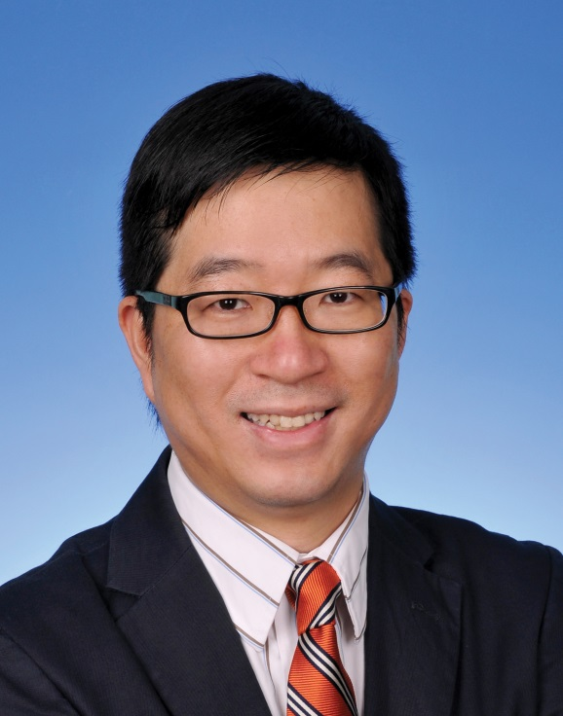
物色，招募與推薦是一個過程 Prospecting, Recruiting & Sponsoring is a Process
Calvin Ip
總顧問經理級 National Supervising Coordinator
四個佣金週期共賺取HK$76,600
HK$76,600 in 4 Commission weeks
本簡報中提到的收入等級純屬舉例說明，無意代表美安香港超連鎖店主的一般收入，也無意表示任何超連鎖店主皆可賺取同等收入。美安香港超連鎖店主的成功與否，取決於其在發展事業時的努力、才能與投入程度。The income levels mentioned in the following presentation are for illustration purposes only. They are not intended to represent the income of a typical Market Hong Kong UnFranchise Owner, nor are they intended to represent that any given Independent UnFranchise Owner will earn income in that amount. The success of any Market Hong Kong Independent UnFranchise Owner will depend upon the amount of hard work, talent, and dedication which he or she devotes to building his or her Market Hong Kong Business.

Slide 3
大量的 持續的 行動
Massive Consistent Action

Slide 4
名單－ 數字的遊戲 Possibilities List – It’s a number’s game

Slide 5
填滿儲豆罐 Fill the Bean Jar

Slide 6
創造人脈的渠道 Channels to Create Leads
你在找尋甚麼樣的人
業務, 業務經理, 老師, 生意人, 全職媽媽, 健身教練, 化妝師, etc
What kind of people are you looking for?
Sales, Sales Manager, Teachers, Business owners, Mothers, Fitness coach, Make up Artist, etc
FB ‧Instagram ‧ Linkedin

Slide 7
篩選名單 To Qualify Prospects
讚美， 共同點， 聆聽， 關心
有主題性的問話 － FORM
Compliment, Common Ground, Care
Ask Leading Questions - FORM (Theme)
稱讚 Edify
擴展市場 Expanding (Direct)
不知道適不適合你 May or may not
但我相信你一定願意多了解一些資訊
Do you keep your business options open
Build Relationship

Slide 8
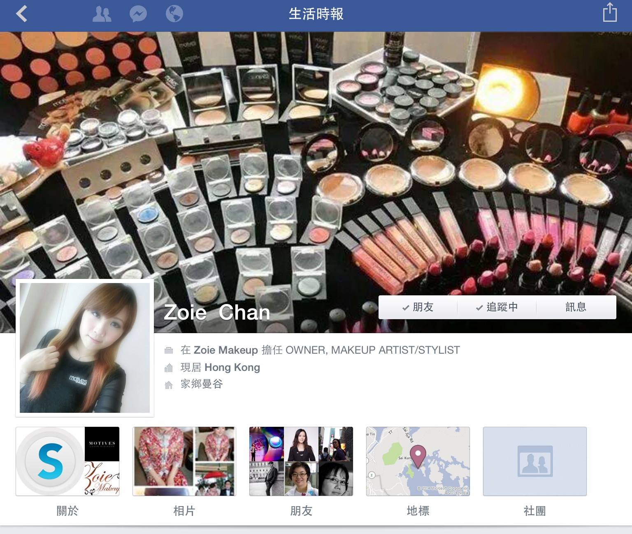
Build Your Image 建立你的形像

Slide 9
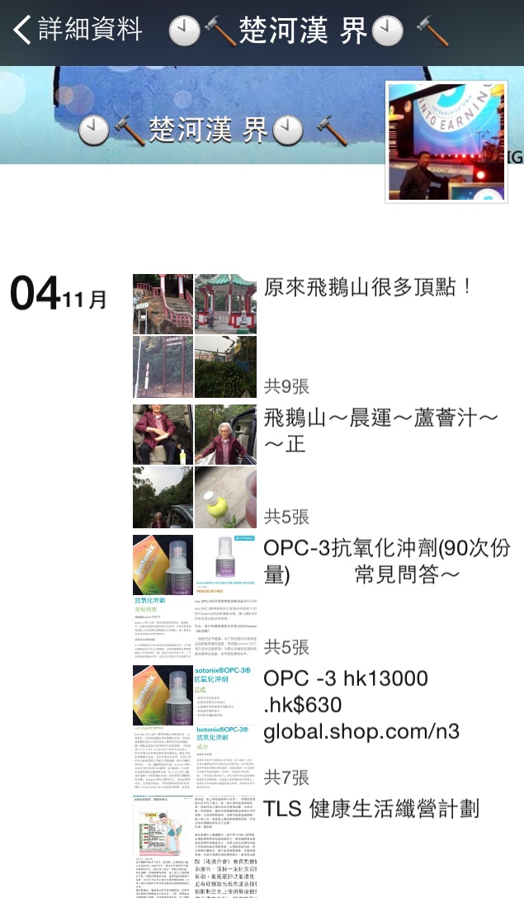

Slide 10
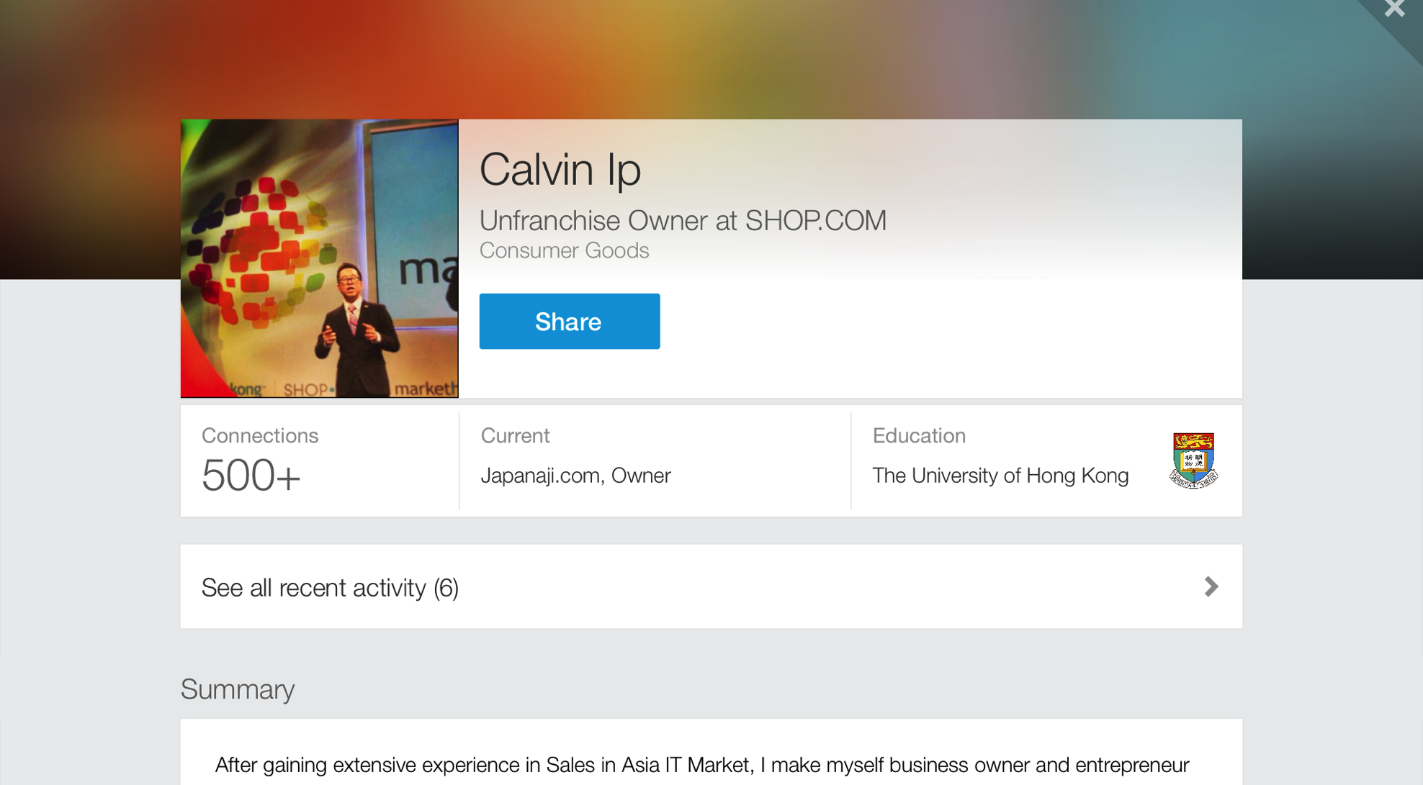

Slide 11
人是吸來的，不是找來的
Become the person you want to recruit

Slide 12
準備好自己 Prepare yourself
2分鐘廣告 （為什麼做美安）
2 mins commercial
甚麼是美安
What is ma

Slide 13
Call Workshop 電話工作坊
我只有幾分鐘的時間 I only have a second
推崇 Edify
這不一定適不適合你， 但是對我都無所謂
May or may not be for you, either way is fine with me
但我相信你一定可以幫到我 Help me out
時間， 地點 Time, Location
從現在到那天有任何原因來不了嗎？
From now until then, any reason
我會提前一天打電話提醒你
Remind you

Slide 14
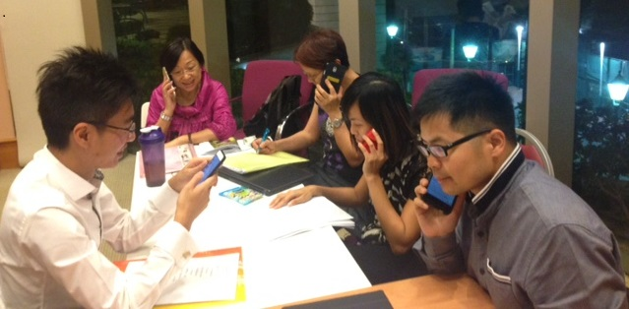
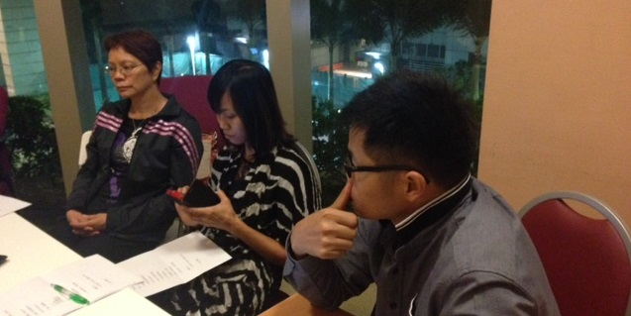
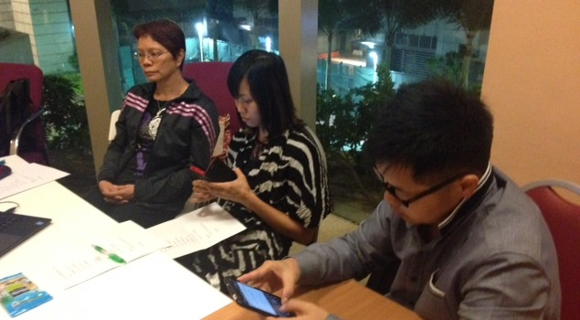
Call Workshop 電話工作坊

Slide 15
美安沒有失敗， 只有失敗去邀約 There is no failure in MHK, only failure in making appointments

Slide 16
預先安排好的邀約 才會有成果 What gets SCHEDULED, gets DONE

Slide 17
超連鎖事業簡介紹 Play the Video

Slide 18
找到自己的成功比例 Find your own ratio

Slide 19
運用數字法則 是致勝之道 What we lack in skills, can be made up by numbers

Slide 20
有效跟進 – Effective Follow Up 關鍵都在下一次
1. 優惠顧客 – 產品 / Autoship
Product / Autoship
2. 約下次見面/ 主辦一次活動
Follow Up /Next Step
3. 新人快速起步 (FSK)
票
TICKET
&
Schedule
HWP/HBP

Slide 21
Fast Start Kit

Slide 22
新人起步指南
Getting Started Guide
下次大會的門票
Ticket to next Convention
設定會議聯盟系統 訓練 + 2 對1會面
Schedule NMTSS training+ 2 to 1

Slide 23
掌控我能掌控的， 其他的都會在我掌控之中 Do more of what you know works, less of what you know doesn't

Slide 24
創造業績，不是等待業績 Create BV, not Wait for BV
就去行動!
Just do it!

